Slide 1
The bus ticketing system
Customer Aspect
Group #16
Project Manager
Mohammad Said Rabe 11516042
Group members
Suhaib Gargoum 115202103
Omar Altahan 115200017

Slide 2
Introduction
This section gives a scope description and overview of everything included in this project. Also, the purpose for this document is described and a list of abbreviations and definitions is provided.

Slide 3
purpose
This software helps people to find and reserve bus trips with suitable route, date, time and seat. When connects to the internet, it provides a list of cities and trips which customer would travel by.

Slide 4
description
The software considers the customer aspect.
The software is designed to be used by customers to maintain regular buses between multiple locations by using an online database. It takes the customer’s route choice and retrieves the trips’ data and schedules from the used internet server of Metro tourism company’s database. Then, the customer will choose a suitable trip with date, time and seat and fill his/her personal information to the system, then all trip and customer data will be saved to the software’s database with a unique ticket number generated. With personal information, a customer can view, change and delete his/her previously reserved ticket.

Slide 5
Risks and management
The first step in the risk management process is to identify the risk itself, so that appropriate countermeasures can be taken.
Server failure: bad internet connection or other server problems may cause system corruption, as an alternative, we should have a spare server.
When customers fill data to the system, they could enter some unwell formatted expressions such as date entry. To manage this risk, an autofill date picker has been used to help users enter well formatted data.
Wrong personal information entry when registering for new ticket. Ex. entered national ID is less than 11 digits.

Slide 6
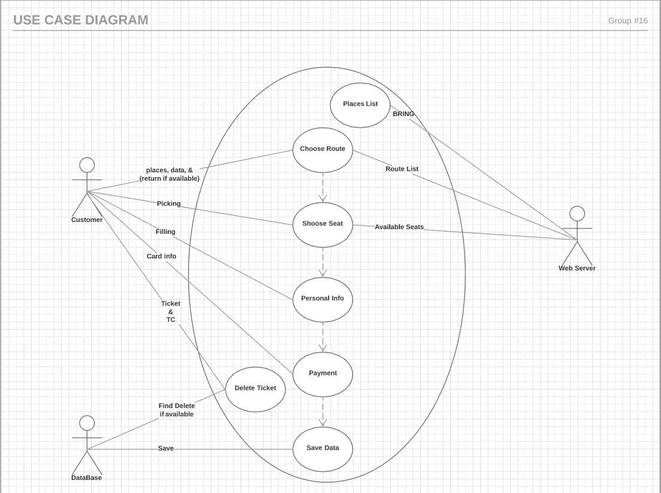
Use case diagram
USE CASE DIAGRAM

Slide 7
Test plan
Purpose
This test plan describes the testing approach and overall framework that will drive the testing of the Bus Ticketing System, the customer aspect.
Project Overview
This software provides the customers the ability to find and reserve a bus trip and buy a ticket using a user-friendly interface giving essential personal information.
Test Strategy
The objective of the test is to verify that the functionality of The Bus Ticketing System (Customer Aspect) works according to the specifications.
Functional Testing
During functional testing, testing team have loaded trial data to the program many times with different routes and trip types (one/multi way) followed by personal information (Name, Surname, TC, Birthdate).

Slide 8
Cont. Test plan
Test Principles
Testing will be focused on meeting the business objectives, cost efficiency and quality.
Testing processes will be well defined, yet flexible, with the ability to change as needed.
Testing activities will build upon previous stages to avoid redundancy or duplication of effort.
Testing will be a repeatable, quantifiable, and measurable activity.
Levels of testing
Internet connection and cities list Data retrieving test.
Trip, Route, and Dates finding, and Data entering tests.
Payment and Ticket confirmation test.
Modify an existing ticket.

Slide 9
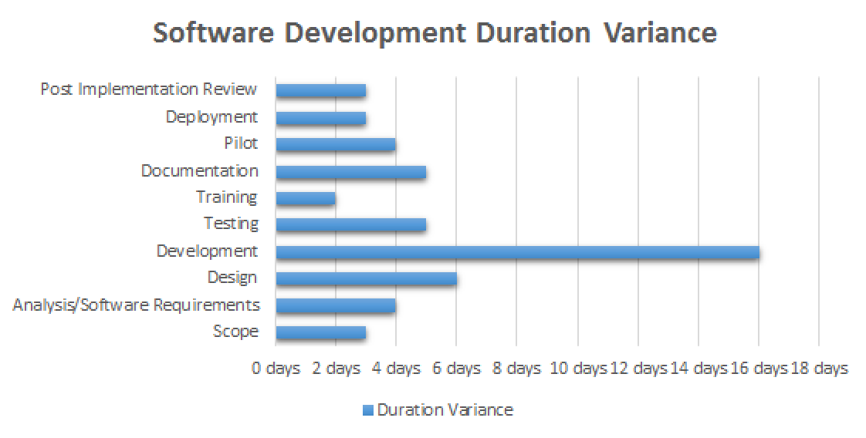

Slide 10
User guide
To have the software working properly, it is necessary to have the used computer connected to the internet.
By the incredible interface that is been implemented in the program, the user can easily follow the steps and requirements of the trip.

Slide 11
Database design
There are two databases being used in this program.
An Online Server of the Metro tourism co. for the lists of cities, their routes, and their schedules.
An Offline database to save the customers’ information with their related tickets.

Slide 12
User interface
The program’s interface was designed using the JavaFX graphics and media packages that enables developers to design, create, test, debug, and deploy rich client applications that operate consistently across diverse platforms.

Slide 13
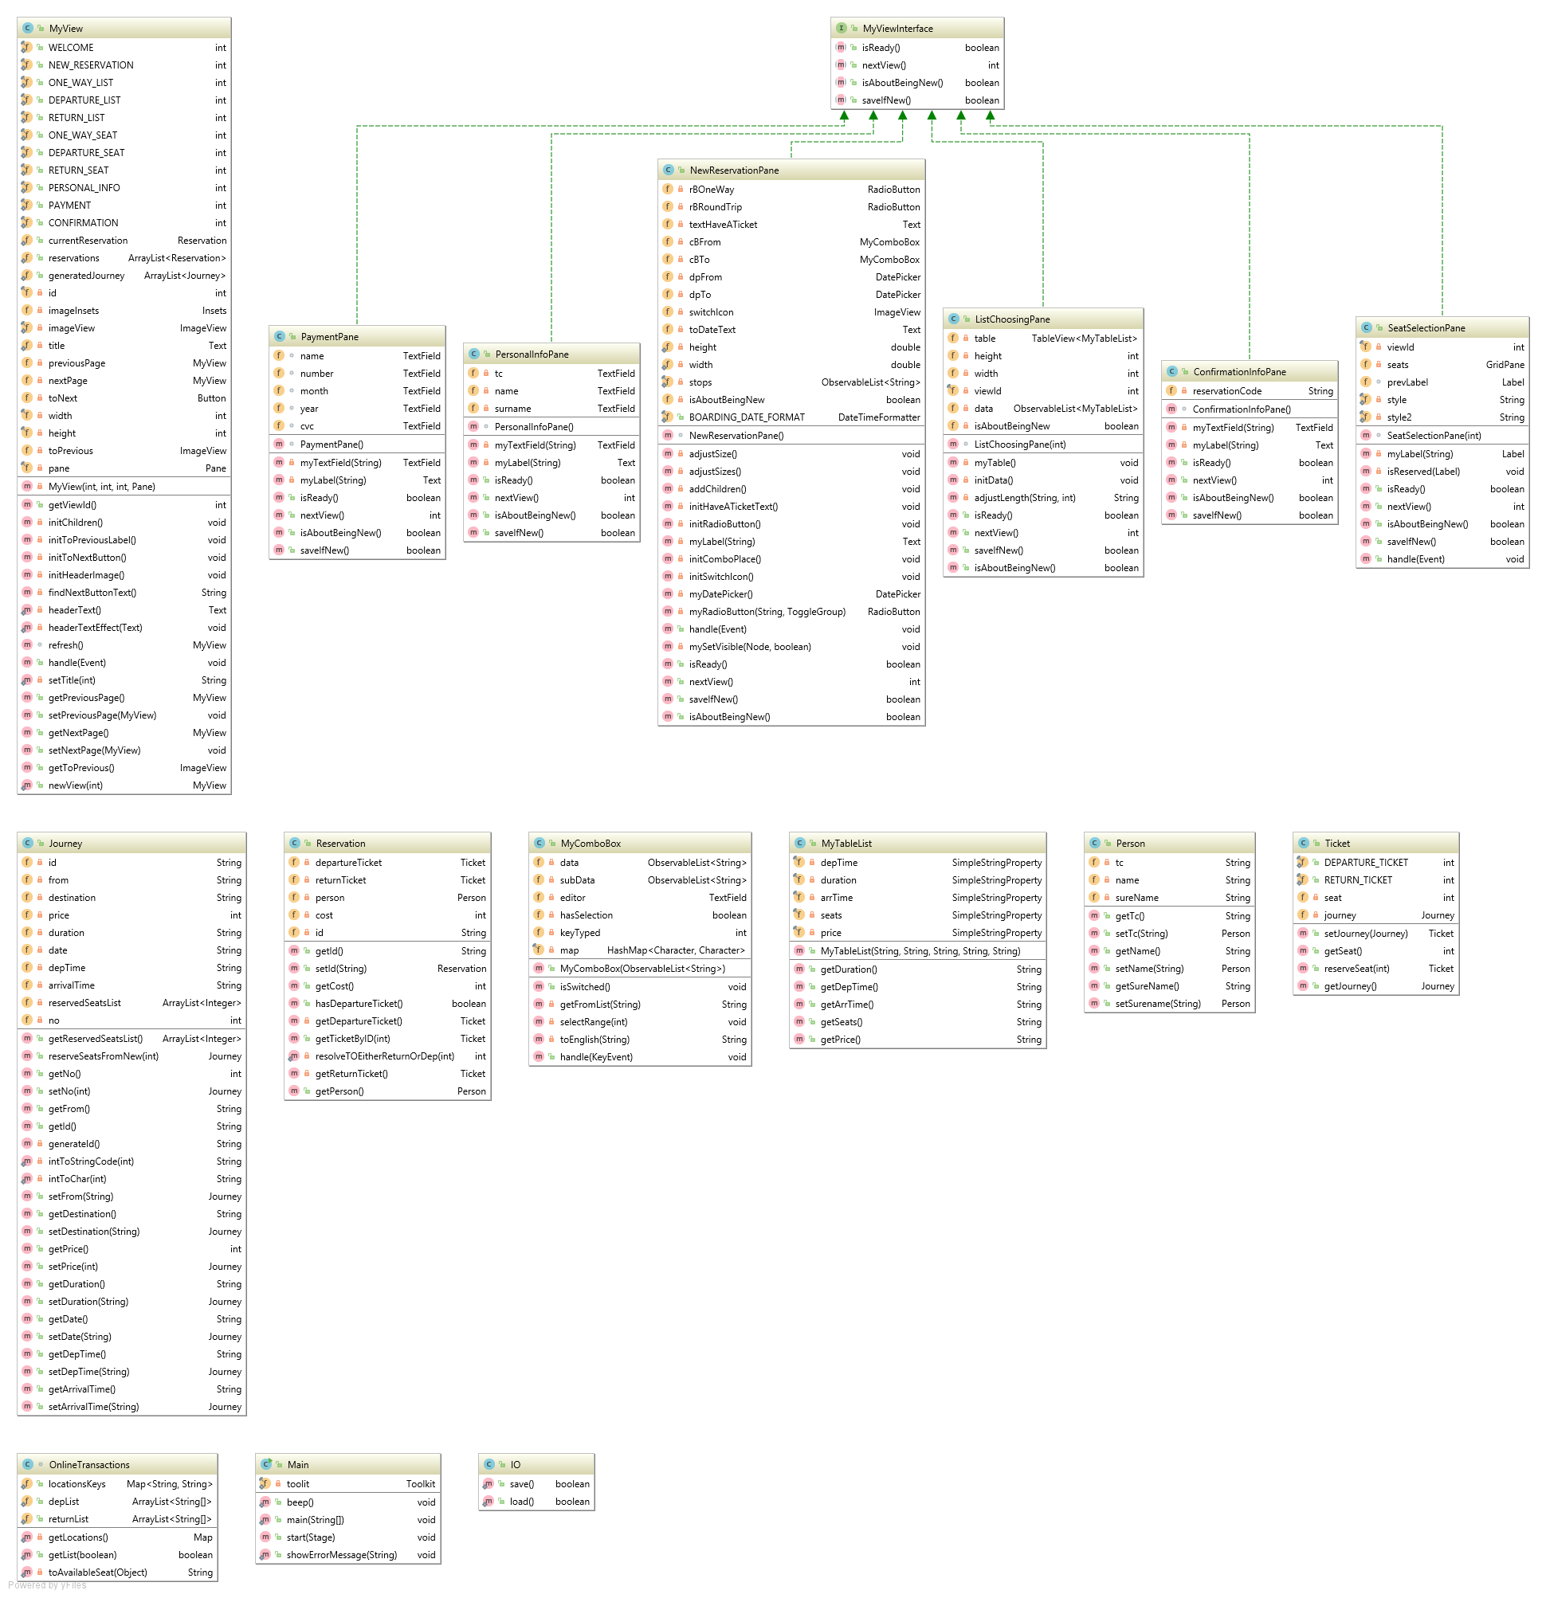

Slide 14
An issue to handle
There were some challenges we have faced during the development process of the project, we will mention one of them.
- In order to distinguish between journeys, we had to use departure, destination, year, month, day, & route Number as an ID, which causes a very long ID.
As a solution for this problem, we have used Alpha-Numeric system which uses uppercase, lowercase, and digits as an ID.
From Dest. Year month day route no.
Before: _ _ _ _ _ _ _ _ _ _ _ _ _ 13 digits to distinguish a journey
After: _ _ _ _ _ _ _ _ _ 09 digits to distinguish the it
We used both uppercase and lowercase latın letters to mınımıze the consumption of digits, rather than using only integers before.
- To define seat number, we only add that number to the end of the journey ID.

